Slide 1
Tech Army V.02

Slide 2

Want to take & manage students' idea?

Slide 3

ideaBook can be your solution

Slide 4
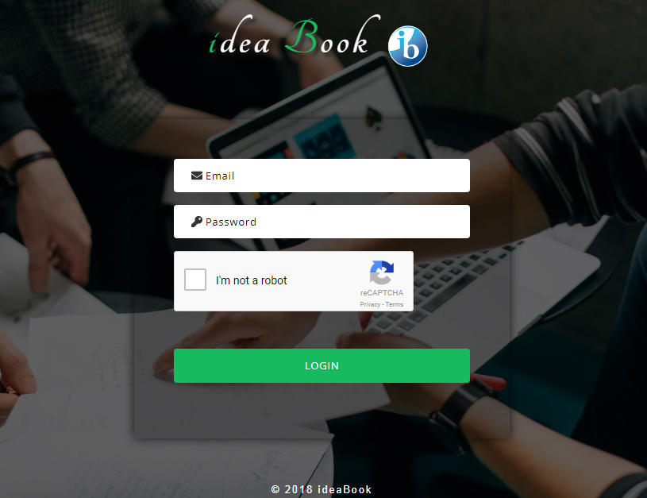
It’s a secured web system.
Notes:
It’s a secured web system.

Slide 5
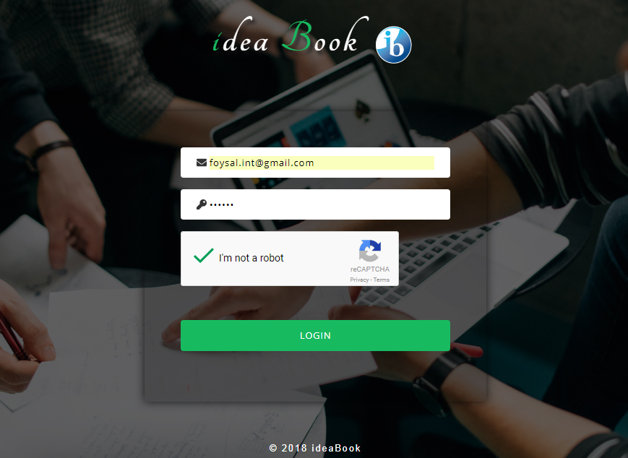

Attempting to login as QAM

